Slide 1
When Shall I Be Empathetic? The Utility of Empathetic Parameter Estimation in Multi-Agent Interactions
Yi Chen, Lei Zhang, Tanner Merry, Sunny Amatya, Wenlong Zhang, Yi Ren
Arizona State University
ICRA 2021 Paper #2183

Slide 2
Key ideas
We consider HRI as general-sum dynamic games w/ incomplete information.
Notes:
In this paper, we explored Human Robot Interactions as general-sum dynamic games w/ incomplete information

Slide 3
Key ideas
We consider HRI as general-sum dynamic games w/ incomplete information.
Such games are often approximately solved with (1) parameter estimation…
Human
Joint Prob. | Aggressive | Non-aggressive
Aggressive | 0.1 | 0.5
Non-aggressive | 0.3 | 0.1
Common belief updated through noisy rationality, equilibrial policies, and Bayes inference
Robot
Notes:
In this setting, the game is oftenly solved by estimating parameters of other agents. Then, the estimated parameters are updated over time using Bayesian inference with agent’s observations

Slide 4
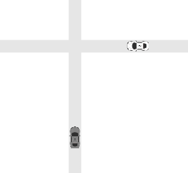

Key ideas
We consider HRI as general-sum dynamic games w/ incomplete information.
Such games are often approximately solved with (1) parameter estimation and (2) motion planning.
Planning according to the estimates:
Human
Joint Prob. | Aggressive | Non-aggressive
Aggressive | 0.1 | 0.5
Non-aggressive | 0.3 | 0.1
Aggressive?
?
Robot
?
Notes:
Once the beliefs are updated through the inference, motion planning is performed to advance in the interaction

Slide 5
Key ideas
We consider HRI as general-sum dynamic games w/ incomplete information.
Such games are often approximately solved with (1) parameter estimation and (2) motion planning.
Existing work often assume the robot’s (ego agent’s) parameters are known by the human, i.e., the robot does not acknowledge human’s misunderstanding of its parameters, thus the robot is non-empathetic.
Human
Robot: “I’m non-aggressive, therefore you are aggressive”
?
Joint Prob. | Aggressive | Non-aggressive
Aggressive | 0.1 | 0.5
Non-aggressive | 0.3 | 0.1
?
Robot
Notes:
Now, we introduce the empathy of the agents. A non-empathetic agent assumes its own parameters are known by the other agent. Meaning, the ego agent does not consider the possibility of misunderstanding of its parameters by the other agent

Slide 6
Key ideas
We consider HRI as general-sum dynamic games w/ incomplete information.
Such games are often approximately solved with (1) parameter estimation and (2) motion planning.
We model all agents to allow misunderstanding, thus they are empathetic.
Human
Robot: “The best explanation is you believed I’m aggressive, and I believed you are non-aggressive.”
?
Joint Prob. | Aggressive | Non-aggressive
Aggressive | 0.1 | 0.5
Non-aggressive | 0.3 | 0.1
Joint Prob. | Aggressive | Non-aggressive
Aggressive | 0.1 | 0.5
Non-aggressive | 0.3 | 0.1
?
Robot
Notes:
On the other hand, in the case of the empathetic agent, the ego agent acknowledge the possibility of misunderstanding between the agents.

Slide 7
Key ideas
We consider HRI as general-sum dynamic games w/ incomplete information.
Such games are often approximately solved with (1) parameter estimation and (2) motion planning.
We model all agents to allow misunderstanding, thus they are empathetic.
This requires computing the whole belief table.
This paper: In what cases would empathy be beneficial?
Human
Robot: “The best explanation is you believed I’m aggressive, and I believed you are non-aggressive.”
?
Joint Prob. | Aggressive | Non-aggressive
Aggressive | 0.1 | 0.5
Non-aggressive | 0.3 | 0.1
Joint Prob. | Aggressive | Non-aggressive
Aggressive | 0.1 | 0.5
Non-aggressive | 0.3 | 0.1
?
Robot
Notes:
In this paper, our goal is to find out when being empathetic is beneficial, to itself and to the other agent as well

Slide 8
Key contributions
Systematically evaluate the advantages of empathy using a space spanned by the initial system states, agent parameters, and the prior common belief about the parameters.
Notes:
Our research contributed by examining the advantages of empathetic agents given a space spanned by a set of initial states, agent parameters as well as the prior common belief about agent’s parameters.
(Our research contributed by examining the advantages of empathetic agents given a set of initial states, agent parameters and the prior common belief )

Slide 9
Key contributions
Systematically evaluate the advantages of empathy using a space spanned by the initial system states, agent parameters, and the prior common belief about the parameters.
Through a two-vehicle uncontrolled intersection case, we show that empathy leads to better values when parameters and common beliefs are inconsistent (e.g., everyone being aggressive while believing all to be nonaggressive).
Notes:
We experimented the settings between non-empathetic agents and empathetic agents in a two-vehicle uncontrolled intersection, showing that empathetic agents results in higher values, when the initial common belief are inconsistent with the ground truth parameters of each agent.
(We experimented in a two-vehicle uncontrolled intersection case, showing that empathetic agents results in higher values, when the given initial common belief are inconsistent with the ground truth parameters.)

Slide 10
Key contributions
Systematically evaluate the advantages of empathy using a space spanned by the initial system states, agent parameters, and the prior common belief about the parameters.
Through a two-vehicle uncontrolled intersection case, we show that empathy leads to better values when parameters and common beliefs are inconsistent (e.g., everyone being aggressive while believing all to be nonaggressive).
To enable fast empathetic parameter estimation and motion planning, we develop a learning architecture for approximating Nash equilibrial action-values for given agent parameters.
Notes:
To enable fast empathetic parameter estimation and motion planning, we develop a learning architecture for approximating Nash equilibrial action-values for given agent parameters.

Slide 11
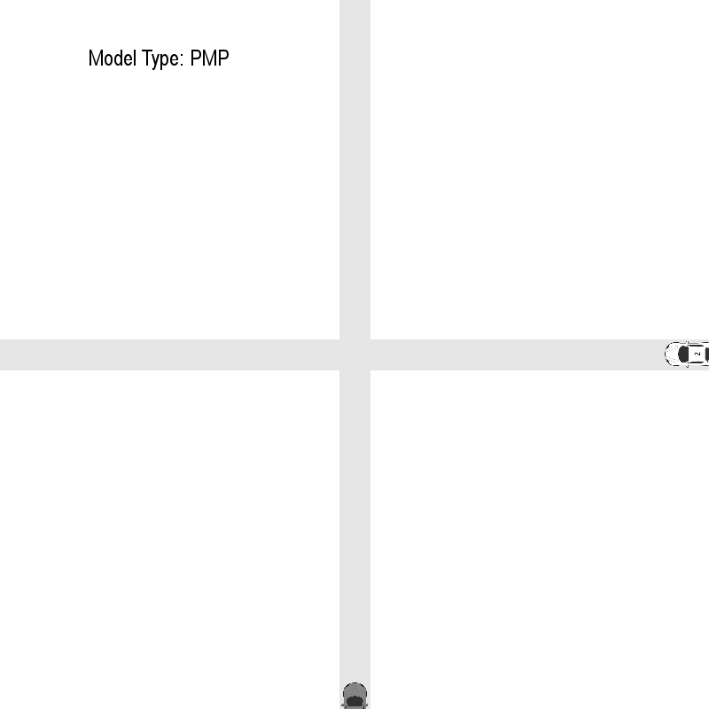
Supplementary Animations
Equilibrial interactions w/ complete info, based on PMP.
P2
P2
Farther
Closer
P1
P1
Non-aggressive vs. Non-aggressive: Larger distances between agents
Aggressive vs. Aggressive: Closer distances between agents
Notes:
(15, 16) Here we demonstrate animated interactions omitted from the paper due to space limitation.First we provide the interaction results base on PMP, in non-aggressive versus non-aggressive settings
(2: Here we demonstrate animated interactions.First we provide the interaction results base on PMP, in non-aggressive versus non-aggressive settings and aggressive vs aggressive settings)
Please pay attention to...

Slide 12
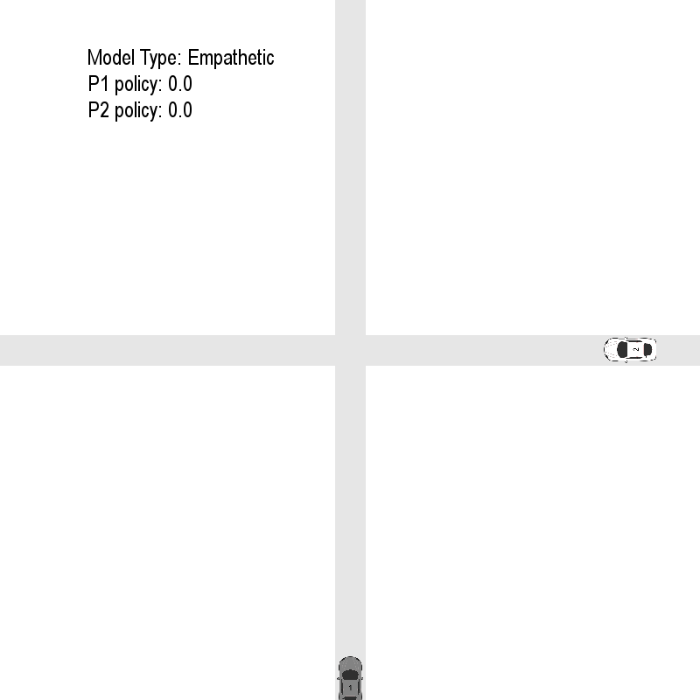
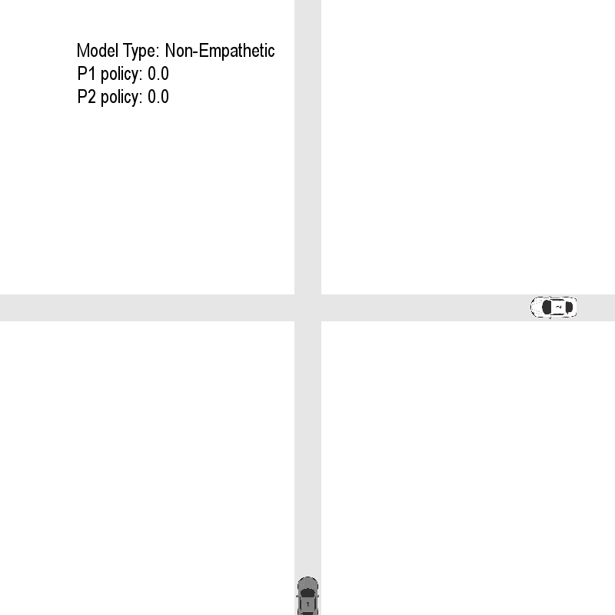
Supplementary Animations
Policy:
1: Correct belief
0: Wrong belief
P2
P2
Empathetic:
Farther
None-Empathetic:
Closer
P1
P1
Common belief inconsistent w/ aggressiveness
Non-aggressive agents believe all to be aggressive (16, 19)
Notes:
(16, 19) Next, we show the interactions cases between empathetic and non-empathetic agents, with the same initial states, initial common belief. In the non-empathetic case, it’s clear that 2 cars had a closer call, and the policy converged quickly to the right parameter belief for empathetic but not for the non-empathetic.
(Next, we show the interactions cases between empathetic and non-empathetic agents, with the same initial common belief. In the non-aggressive case, it’s clear that empathetic agents were able converge to the right policy quickly and remain safer distance )

Slide 13
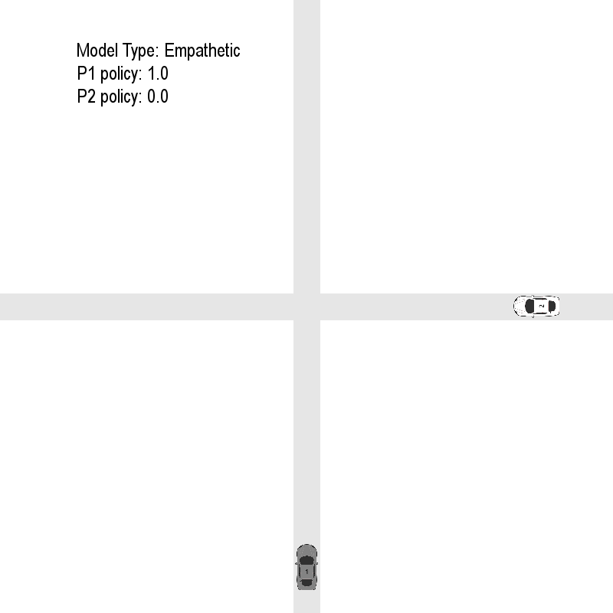
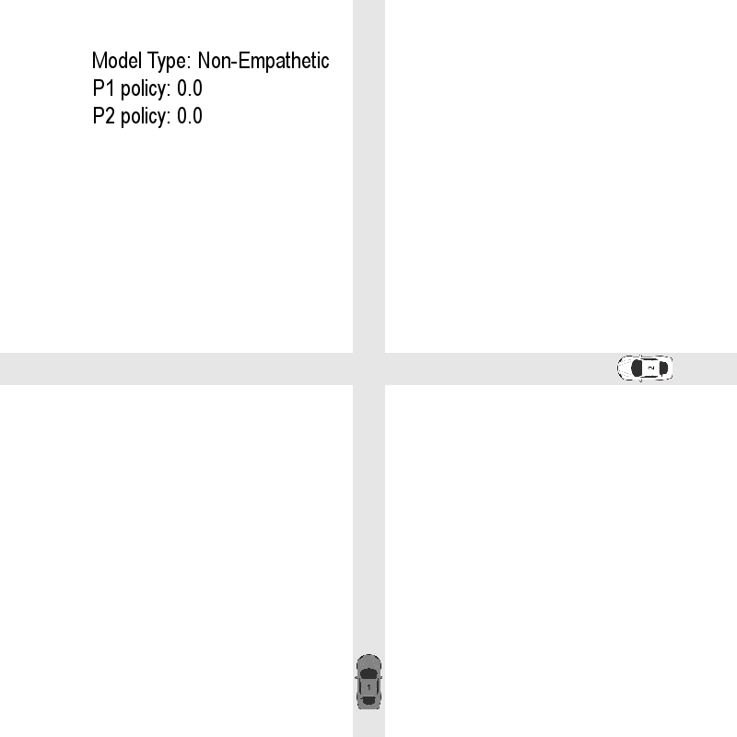
Supplementary Animations
Policy:
1: Correct belief
0: Wrong belief
P2
P2
Empathetic:
Farther
None-Empathetic:
Closer
P1
P1
Common belief inconsistent w/ aggressiveness
Aggressive agents believe all to be non-aggressive
Notes:
(18, 20) in the aggressive case, non-empathetic agents misunderstood each other as non-aggressive and will either yield or accelerate to avoid collision. With this false belief, the agents choose to move forward until it is too late to avoid a collision.

Slide 14
Limitations and Future Directions
Incorporate uncertainty: Currently we’re using equilibrial policies from deterministic differential games. Incorporating uncertainty in belief would need an extension to stochastic games (w/ expected value over parameter space)
Human
Joint Prob. | Aggressive | Non-aggressive
Aggressive | 0.1 | 0.5
Non-aggressive | 0.3 | 0.1
Current: Policy chosen from point estimates
Robot
Notes:
In this paper we explored the advantages of empathetic agents, for that purpose we used equilibrial policies from deterministic differential games. In the future we’d like to extend to incorporating uncertainty in our interactions for higher fidelity where there could be modeling errors, which would results in a stochastic game.

Slide 15
Limitations and Future Directions
Incorporate uncertainty: Currently we’re using equilibrial policies from deterministic differential games. Incorporating uncertainty in belief would need an extension to stochastic games (w/ expected value over parameter space)
Human
Joint Prob. | Aggressive | Non-aggressive
Aggressive | 0.1 | 0.5
Non-aggressive | 0.3 | 0.1
Ongoing: Policy chosen from marginal prob.
Robot

Slide 16
Limitations and Future Directions
Incorporate uncertainty: Currently we’re using equilibrial policies from deterministic differential games. Incorporating uncertainty in belief would need an extension to stochastic games (w/ expected value over parameter space)
More generalizable value approximation: Currently trained on equilibria w/ few collisions. Need wider range of equilibria for better policies in corner cases (i.e., more accurate value approximation to the Hamilton-Jacobi-Isaac solutions).
Notes:
The current value network are specific for the intersection cases. Extending the value approximation by obtaining wider range of equilibria is the next step for implementation on more types of interaction cases.

Slide 17
Limitations and Future Directions
Incorporate uncertainty: Currently we’re using equilibrial policies from deterministic differential games. Incorporating uncertainty in belief would need an extension to stochastic games (w/ expected value over parameter space)
More generalizable value approximation: Currently trained on equilibria w/ few collisions. Need wider range of equilibria for better policies in corner cases (i.e., more accurate value approximation to the Hamilton-Jacobi-Isaac solutions).
Are people empathetic? Inverse estimation of human driver empathy using the proposed model and existing traffic data is ongoing.
Notes:
Last but not least, we’d like to look into the empathy of human drivers by inversely estimating their parameters using the proposed model on existing traffic data in the future.

